Slide 1
Project 5
By Chong

Slide 2
Data Cleaning
Predicted age based on siblings, spouses, parents, children, and fare.
Preprocessed with RobustScaler
Dropped:
  Index
  PassengerID
  Ticket
  Cabin
  Name

Slide 3
Models
Ran the following models:
  Decision tree
  Gradient boosted decision tree
  Adaboosted decision tree
  Bagged decision tree
  Random forest
  KNN
  Linear SVM
  Rbf SVM
  Logistic Regression
  Neural net with 2 hidden layers, with 20 hidden neurons in total
… and also gridsearched versions of all of these

Slide 4
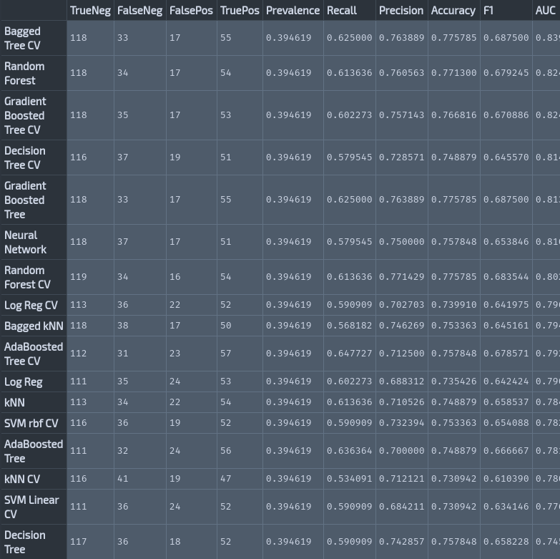
Results
Bagging, boosted, and randon forests had best performance.
SVMs had the worst accuracy, kNN had the worst F1 score, Vanilla decision tree had the worst AUC.

Slide 5
Discussion
All methods had basically the same accuracy.
The selection process in real life was almost a decision tree
Dataset may have been too small for the effects of hyperparameter optimization to even overcome noise.
When datasets get huge, neural nets improve by a LOT while other methods only improve a little.

